Slide 1
Project 4 - Team Spam
Data Analytics Bootcamp - Project 4
Notes:
Lincoln

Slide 2



Team Spam - Members
Chris Finklea
Lincoln Martin
Sharada Muthusubramanian
Sharada
Lincoln
Chris
Notes:
Lincoln

Slide 3
Questions to answer
Create a ML model that predicts spam vs. non-spam emails to help reduce mailbox cluttering
Understand what kind of words are more prominent for each of the categories
Understand how accurate the ML model is
Notes:
Lincoln

Slide 4
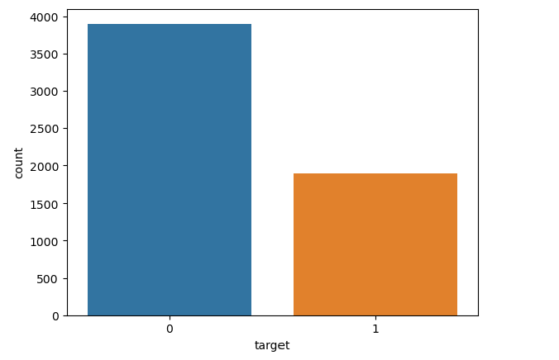
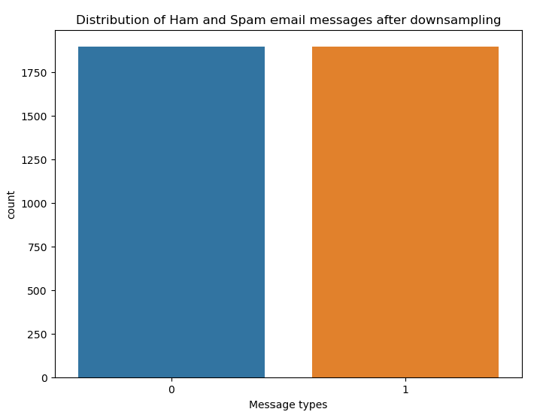
Spam vs. Non-spam distribution Orig and normalized
Email spam/non-spam distribution - orig
Email spam/non-spam distribution - Normalized
Notes:
Chris

Slide 5
Data Cleansing steps before creating model to optimize the prediction
Data cleansing process: Installed NLTK to remove stopwords (stop words are common words like a, an, and, it, she, they etc.)
Removed punctuations before splitting the words
Cleaned email data prior to splitting the words; checked the frequency of common words by leveraging WordCloud
Notes:
Chris

Slide 6
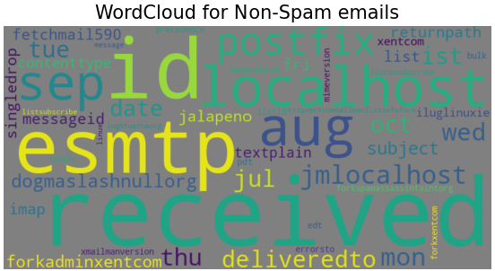
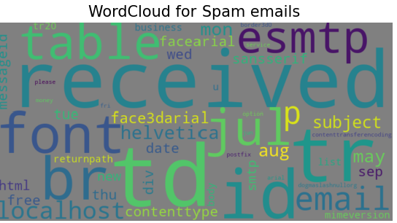
Explanation of Word Cloud
Spam emails has words like free, money , face3darial etc. through both had received and esmtp as higher volume letters.
Notes:
Chris

Slide 7
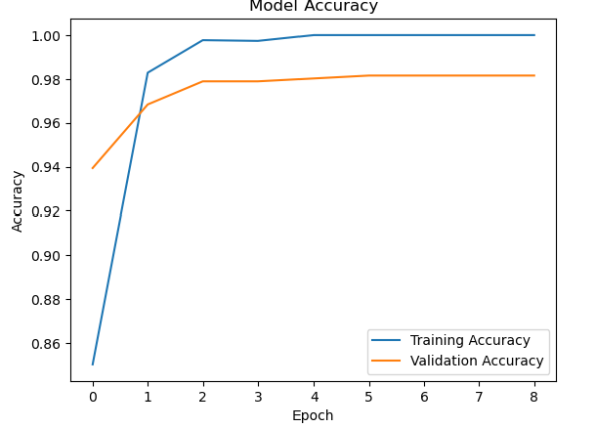
ML scores
Created test and train split
Built tf.keras sequential model with density of 32 nodes and 1 node. With relu and sigmoid activation
Model Evaluation (loss/accuracy):
Test Loss : 0.06512466818094254
Test Accuracy : 0.9815546870231628
Model has 98% accuracy with only 6% loss
Model reached optimization at 7 to 10 epoch
Notes:
Sharada

Slide 8
Thank you!
Any Questions?

